Slide 1
Sustainable Marketing
Lecture 11 | Chapter 20

Slide 2
Sustainable Marketing
Sustainable marketing – calls for socially and environmentally responsible actions that meets the present needs of consumers and businesses while also preserving or enhancing the ability of future generations to meet their needs.
Needs of Consumers | Needs of Business
 | Now | Marketing concept | Strategic planning concept
 | Future | Societal marketing concept | Sustainable marketing concept
 |  | Now | Future

Slide 3
Sustainable Marketing
Societal marketing concept - considers the future welfare of consumers
Strategic planning concept – considers future company needs
Sustainable marketing concept - considers both;
calls for socially and environmentally responsible actions that meet both the immediate and future needs of customers and the company
Marketing concept - recognises that organisation thrives from day to day by determining the current needs and wants of target group customers and fulfilling those needs and wants more efficiently than the competition
Focuses on the short-term sales, growth and profits by giving customers what they want

Slide 4
Marketing’s impact on individual consumers
High prices
High costs of distribution
High A&P costs
Excessive mark-ups
Deceptive practices
Deceptive pricing, promotions & packaging
High-pressure selling
Shoddy, harmful or unsafe products
Poor quality
Deliver little benefit
Cause harm
Planned obsolescence
Poor service to disadvantaged customers

Slide 5
Marketing’s impact on society as a whole
False wants and too much materialism
Cultural pollution
when our sense are constantly being assaulted and bombarded by advertising and marketing; when our privacy becomes pirated
Too few social goods
overselling of private goods at the expense of public goods

Slide 6
Marketing’s impact on other businesses
Acquisition is a complex subject
Acquisition of competitors
Barriers to entry
Unfair practices

Slide 7
Consumer actions to promote sustainable marketing
Consumerism
an organised movement of citizens and government to improve the rights and power of buyers in relation to sellers
Environmentalism
an organised movement of concerned citizens and government agencies to protect and improve people’s living environment

Slide 8
Environmental Sustainability
 | Today: Greening | Tomorrow: Beyond Greening
Internal | Pollution prevention eliminating or reducing waste before it is created | New clean technology developing new sets of environmental skills and capabilities
External | Product stewardship minimising environmental impact throughout the entire product life cycle | Sustainability vision creating a strategic framework for future sustainability

Slide 9
Business actions toward sustainable response marketing
Consumer-oriented marketing
viewing and organising its marketing activities from the consumer’s point of view
Customer-value marketing
placing most of its resources into customer value-building marketing investment
Don’t focus on short-term sales promotions & discounts but invest in long term customer retention & loyalty programs (customer relationship building)
Innovative marketing
continuously seeking real product and marketing improvements (Eg. Adidas x Parley)
Sense-of-mission marketing
defining its mission in broad social terms rather than narrow product terms (Eg. Dove)
Societal marketing
considering consumers’ wants and interests, the company’s requirements and society’s long-run interests (Eg 18Chefs)

Slide 10
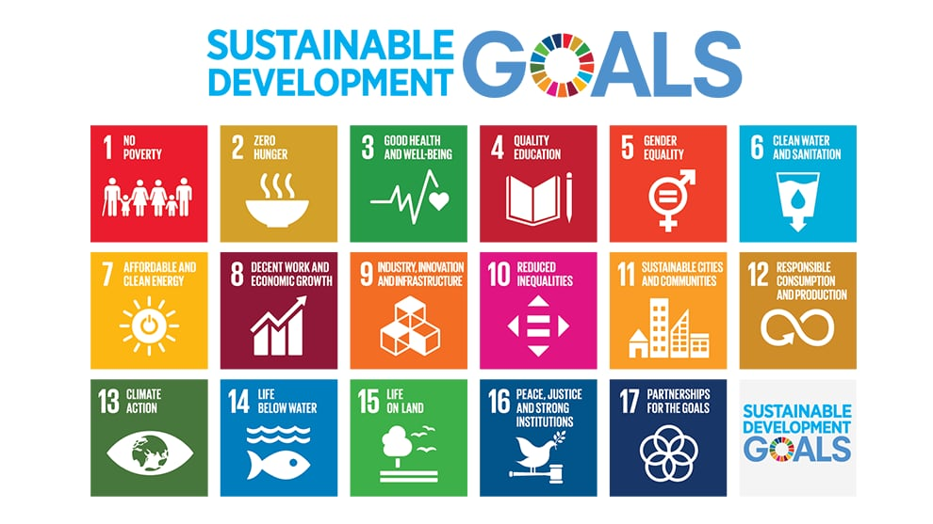
Importance of the United Nations SDGs
The United Nations Sustainable Development Goals (SDGs) are the blueprint to achieve a better and more sustainable future for all.
address the global challenges we face, including those related to poverty, inequality, climate, environmental degradation, prosperity, and peace and justice.
Goals interconnect and in order to leave no one behind, it is important that the world achieves each Goal and target by 2030.

Slide 11
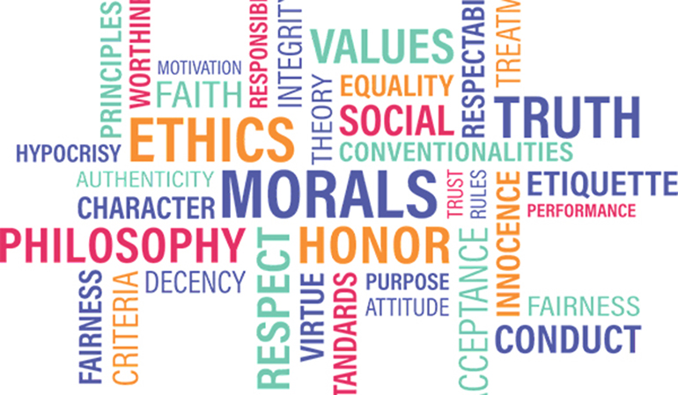
Ethics in Marketing
If the same product is sold by 2 companies: ethical company vs not-so- ethical company, it was found that
92% of Millennial consumers would buy from the ethical company
Increasingly, ethical brands outperform similar companies that lack a commitment to ethical principles

Slide 12
What is Ethical Marketing?
Not a strategy
A philosophy
Shape strategy
Evaluate from (a) business and (b) moral perspectives
Benefit
Customers
Society
Environment
Consistent with marketing orientation
No hard and fast list of rules
Not necessarily against the law
Companies may not consistently engage in ethical marketing

Slide 13
Ethical Marketing covers . . .
Marketing Research
Invasion of privacy
Target Audience
Stereotyping
Discourage demand from “undesirable” segments (e.g., plus-size markets, ethnic minority)
Production
Low pay/Poor working conditions
Child labour
Product
Planned obsolescence
Pricing
Bid rigging
Predatory pricing
Distribution
Unsolicited (telemarketing)
Spam
Advertising
Deceptive
Mere puffery vs Fraud
Promotion
“Bait and switch”
Pyramid scheme

Slide 14
Principles of Ethical Marketing
Marketing communications share the common standard of truth
Marketing professionals abide by the highest standard of personal ethics
Advertising is different from news and entertainment content
Marketers should be transparent in who they pay to endorse their products
Consumers should be treated fairly
Consumer privacy should not be compromised
Marketers must comply with regulations and standards established by govt
Ethics should be discussed openly when making marketing decisions

Slide 15
Types of Unethical Advertising
Surrogate Advertising
a form of advertising which is used to promote banned products, like cigarettes and alcohol, in the disguise of another product.
Exaggeration
False claims about product’s quality
Unverified Claims
No scientific evidence (stronger, shinier hair)
Stereotyping
Sexist culture
False Brand Comparison
Cannot spread misinformation

Slide 16
Ethical Marketing Plan
Analysis of company, customers and markets it operates in
If prohibitive cost, ethics abandoned
Decide what values cannot be compromised
Make honest claims
Avoid marketing to children
Leverage capital from ethical decisions

Slide 17
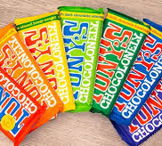
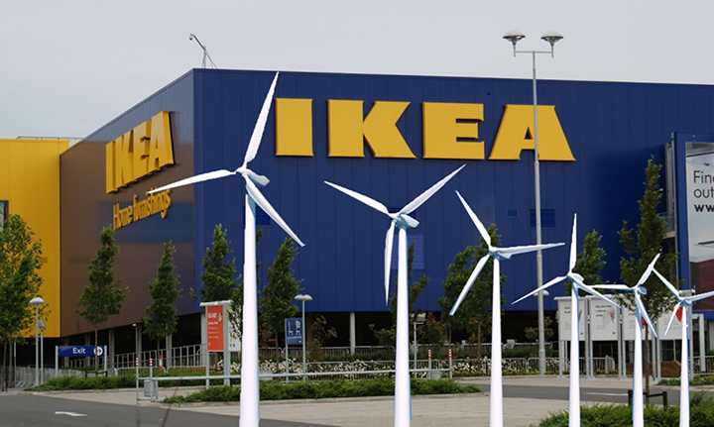
Best Practices
Some companies that make it their mission and commitment to protect planet, people & profit (aka triple-P bottom line)

